Slide 1

Lecture 3
Operators & Conditional Statement

Slide 2

Agenda
Overview
Operators
Conditional Operators
Short Circuit Evaluations
Dual Nature of =
Conditional Statements
  if, switch, ?

Slide 3
Overview

Slide 4
Operators, Conditions, Conditional Statements
Conditional Statements: A piece of code that would divert to different actions based on different conditions
Conditions: to represent a criteria in code, evaluate as a boolean
Operators: to operate on variables (e.g. + - * /)
Conditional Statement
Conditions
Operators
Composed by
Composed by

Slide 5
Operators, Conditions, Conditional Statements
If (user’s guess equals to answer) -> Print out “You Win”
If (user’s guess does not equals to answer) -> Print out “Try Again”
Conditional Statement
Conditions
Operators
Composed by
Composed by

Slide 6
Operators

Slide 7

What are Operators?
Basically + - * /
But there are some non-mathematical operators as well
Quick shortcut for you to manipulate variables

Slide 8
What operators are available?
Operator | Description
+ | Addition
- | Subtraction
* | Multiplication
** | Exponentiation (ES2016)
/ | Division
% | Modulus (Remainder from Division)
++ | Increment
-- | Decrement

Slide 9
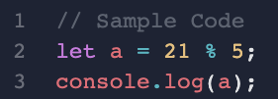
Modulus %
modulus (the remainder of division)
21/5 = 4...1
21%5 = 1
Notes:
https://repl.it/languages/javascript

Slide 10
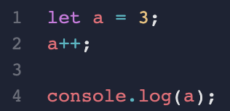
++/--
a shorthand form
  a++ means "a = a + 1"
  a-- means "a = a - 1"

Slide 11
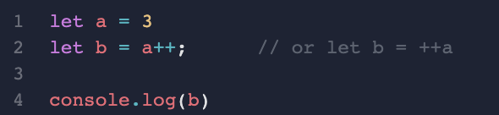
Magic of ++
Notes:
var b = a++; // var b = a; a = a + 1;
var c = ++a; // a = a + 1; var c = a;

Slide 12
Variations of Assignment Operators
Operator | Same as
= | x = y
+= | x = x + y
-= | x = x - y
*= | x = x * y
/= | x = x / y
%= | x = x % y
**= | x = x ** y

Slide 13
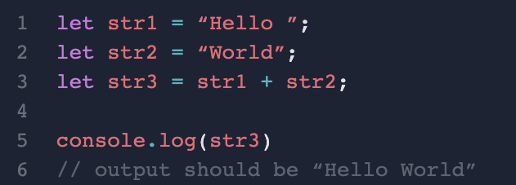
What if we add strings together?
Notes:
Bonus: Can we do minus for string?
Answer is NO

Slide 14
Conditional Operators

Slide 15
Conditional Operators
Easy, but super important
Basically it means comparisons, and return the boolean result (either true or false)

Slide 16
Conditional Operators
Operator | Same as
== | equal to
=== | equal value and equal type
!= | not equal
!== | not equal value or not equal type
> | greater than
< | less than
>= | greater than or equal to
<= | less than or equal to

Slide 17
Logical Operators
Operator | Same as
&& | and
|| | or
! | not

Slide 18
And (&&)
a&&b is true only if both a and b are true
a | b | Result
true | true | true
true | false | false
false | true | false
false | false | false

Slide 19
Or (||)
a||b is false only if both a and b are false
a | b | Result
true | true | true
true | false | true
false | true | true
false | false | false

Slide 20
Not (!)
Returns the opposite value
a | Result
true | false
false | true

Slide 21
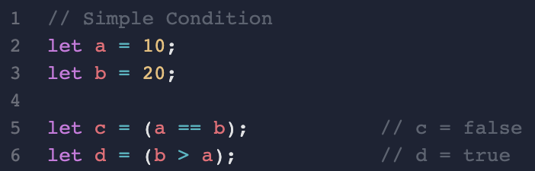
How to use Conditional Operators?

Slide 22
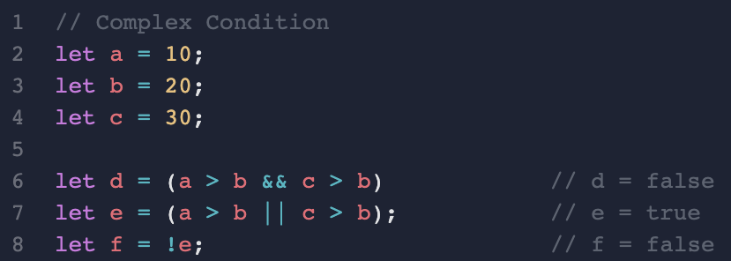
How to use Conditional Operators?
a | b | a && b
true | true | true
true | false | false
false | true | false
false | false | false
a | b | a || b
true | true | true
true | false | true
false | true | true
false | false | false

Slide 23
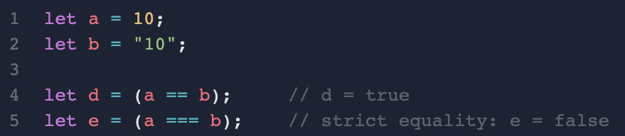
Be careful about ==
*JavaScript only*
Notes:
https://developer.mozilla.org/en-US/docs/Web/JavaScript/Reference/Operators/Strict_equality

Slide 24
Short-circuit Evaluation

Slide 25
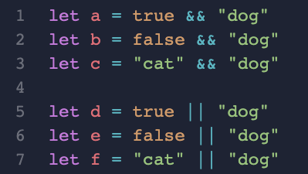
Logical Operators != true/false
Give a guess on the results of the following statements

Slide 26
Short-circuit Evaluation
For &&: if the first part is false, then the second part will not be evaluated
For ||: if the first part is true, then the second part will not be evaluated
Note: only false and 0 are considered as false, other values are all considered as true

Slide 27
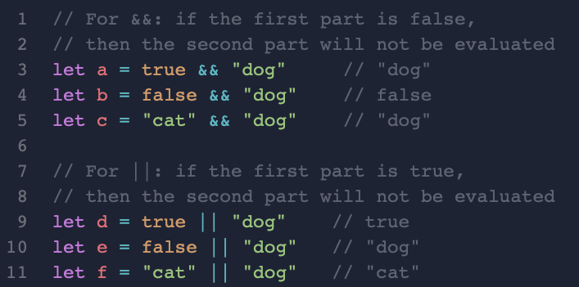
Logical Operators != true/false
Give a guess on the results of the following statements

Slide 28
Dual Nature of "="

Slide 29
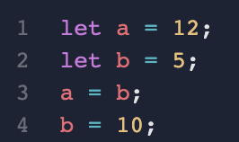
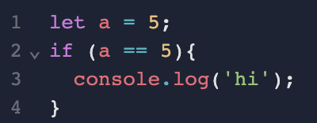
Dual Nature of “=”
Very Very Important
Assignment
Equals to
// what is the value of a and b?
// What is the value of a?

Slide 30
Dual Nature of “=”
= means assigning the right hand side value to left hand side variable
== means comparison, check if the left hand side is equals to right hand side
=== means strict comparison (checking both values and types)
Very Very Important

Slide 31
Conditional Statement - If

Slide 32
Finally, Conditional Statements
There are three types of Conditional Statements
If
Switch
? (Ternary Operator)

Slide 33
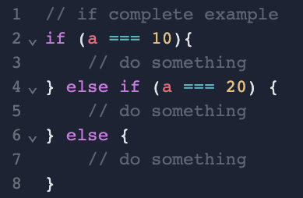
Conditional Statements - If
Notes:
https://developer.mozilla.org/en-us/docs/Web/JavaScript/Reference/Statements/if...else

Slide 34
Conditional Statement - Switch

Slide 35
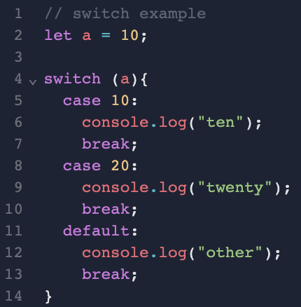
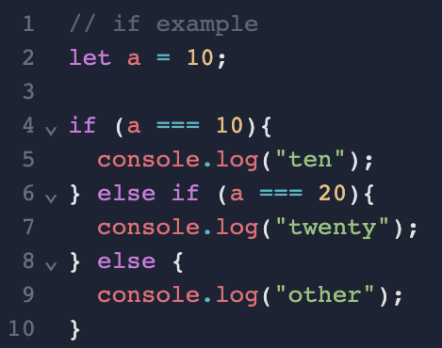
Conditional Statements - Switch
Notes:
// switch example
var a = 10;
switch (a) {
case 10:
console.log("ten");
break;
case 20:
console.log("twenty");
break;
default:
console.log("other");
break; // optional
}

Slide 36
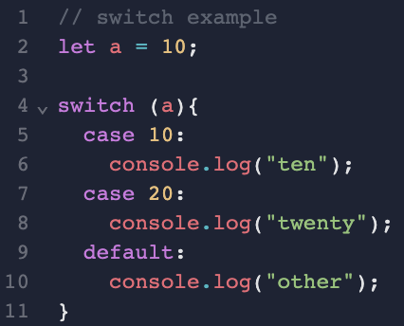
Tricky Switch
Notes:
What will happen if missing break?
https://developer.mozilla.org/en-us/docs/Web/JavaScript/Reference/Statements/switch

Slide 37
Conditional Statement - ? (Ternary Operator)

Slide 38
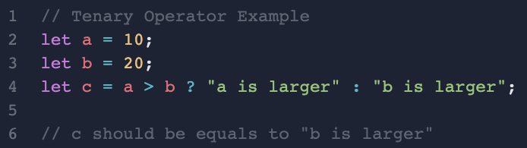
? - Special Conditional Statement
(in fact, it should be an operator)
Ternary Operator: ?
Consider it as shorthand for if … else…
Notes:
// Ternary Operator Example
var a = 10;
var b = 20;
var c = a > b ? "a is larger" : "b is larger";
// c should equals to “b is larger”
console.log(c);
https://developer.mozilla.org/en-US/docs/Web/JavaScript/Reference/Operators/Conditional_Operator

